Slide 1


5. Animation
Let’s Learn
Aj. Andrew Davison, CoE, PSU Hat Yai Campus
E-mail: ad@fivedots.coe.psu.ac.th

Slide 2
Outline
Basic Game Loop Again
Animation Loop for a Ball
Ball Animation 1
Ball Animation 2
Multiple Balls Falling
Bouncing Ball

Slide 3
1. Basic Game Loop Again
pygame.init()
screen = pygame.display.set_mode((640, 480))
screen.fill((255,255,255))
pygame.display.set_caption("Game")
clock = pygame.time.Clock()
running = True
while running: # game loop
clock.tick(30)
# handle events
for event in pygame.event.get():
if event.type == QUIT:
running = False
# update game
# redraw game
pygame.display.update()
pygame.quit()
handle events
update game
redraw game

Slide 4

2. Animation Loop for a Ball
# setup Pygame window as on last slide
# load ball as image
# initialize ball's (x,y) position
# initialize ball's step (xStep, yStep) done in each loop
clock = pygame.time.Clock()
running = True
while running: # game loop
clock.tick(30)
# handle events
for event in pygame.event.get():
if event.type == QUIT:
running = False
# update game
x += xStep; y += yStep
# redraw game
# draw image at (x,y)
pygame.display.update()
pygame.quit()
(x, y)
xStep
yStep

Slide 5
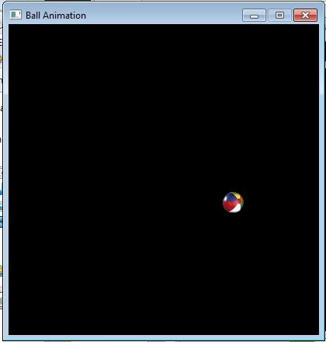
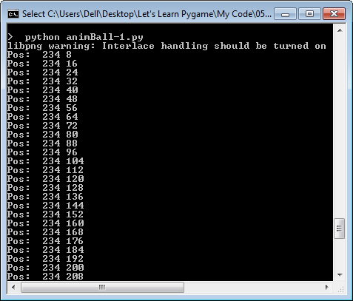
3. Ball Animation 1
The ball starts at a random position along the top, and then drops downwards forever.
the ball's position is printed in the command prompt window

Slide 6
Code: animBall-1.py
pygame.init()
screen = pygame.display.set_mode((400, 400))
pygame.display.set_caption("Ball Animation")
# load ball as image
ballIm = pygame.image.load('smallBall.png').convert_alpha()
# store dimensions for later
scrWidth, scrHeight = screen.get_size()
imWidth, imHeight = ballIm.get_size()
# initialize ball's position
x = random.randrange(0, scrWidth-1 - imWidth)
y = 0
screen.blit(ballIm, [x,y])
# initialize ball's step done in each loop
xStep = 0; yStep = 8
clock = pygame.time.Clock()
:

Slide 7
running = True
while running:
clock.tick(30)
# handle events
for event in pygame.event.get():
if event.type == QUIT:
running = False
# update game state
# Move ball down
y += yStep
print("Pos: ", x, y)
# redraw
screen.fill(BLACK)
screen.blit(ballIm, [x,y])
pygame.display.update()
pygame.quit()

Slide 8
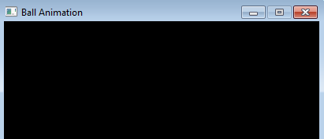
Setting the Ball's Start Position
x = random.randrange(0, scrWidth-1 - imWidth)
y = 0
screen.blit(ballIm, [x,y])
imWidth
scrWidth
(0, 0)
( scrWidth-1,
0)
imWidth
(x, y)
range of x for the ball

Slide 9
Where's the Ball?
The problem is that the ball keeps moving downwards forever, even after it has dropped below the bottom of the screen (y == 480).

Slide 10
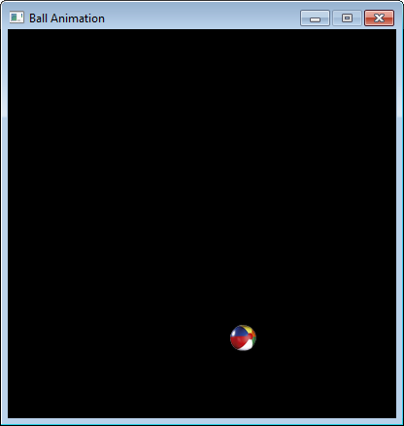
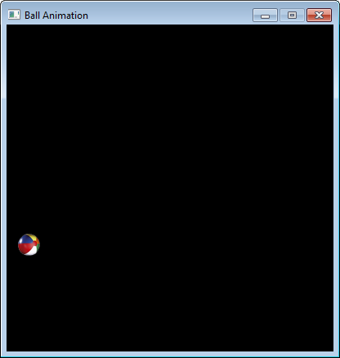
4. Ball Animation 2
When the ball drops off the bottom of the screen, it's (x,y) position is reset to be at a random place along the top.
then
starts
at the
top again

Slide 11
Code: animBall-2.py
screen = pygame.display.set_mode((400, 400))
pygame.display.set_caption("Ball Animation")
# load ball as image
ballIm = pygame.image.load('smallBall.png').convert_alpha()
# store dimensions for later
scrWidth, scrHeight = screen.get_size()
imWidth, imHeight = ballIm.get_size()
# initialize ball's position
pos = randomPos() # pos is the list [x, y]
# screen.blit(ballIm, pos) # not needed usually
# initialize ball's step done in each loop
xStep = 0; yStep = 8
clock = pygame.time.Clock()
:

Slide 12
running = True
while running:
clock.tick(30)
# handle events
for event in pygame.event.get():
if event.type == QUIT:
running = False
# update game state
# if ball has exited bottom
if pos[1] > scrHeight-1:
pos = randomPos()
# Move ball down
pos[1] += yStep
# print("Pos: ", pos)
# redraw
screen.fill(BLACK)
screen.blit(ballIm, pos)
pygame.display.update()
pygame.quit()

Slide 13
randomPos()
def randomPos():
# create a random position
# x position somewhere along top
x = random.randrange(0, scrWidth-1 - imWidth)
y = 0
return [x,y]

Slide 14
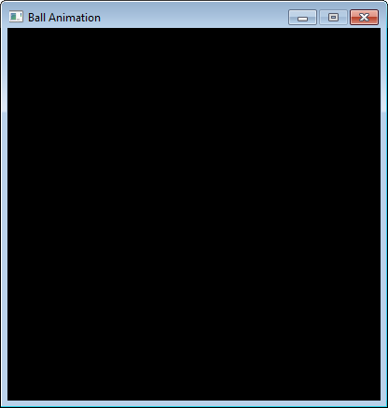
When has the ball left the screen?
if pos[1] > scrHeight-1:
pos = randomPos()
(0, 0)
scrHeight
(0, scrHeight-1)
(x, y)

Slide 15
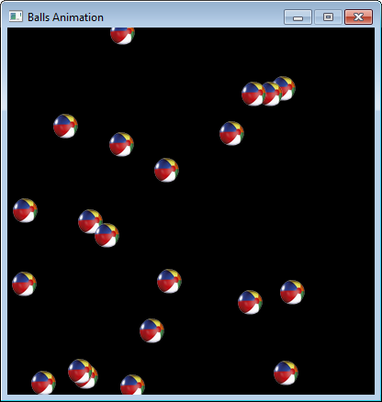
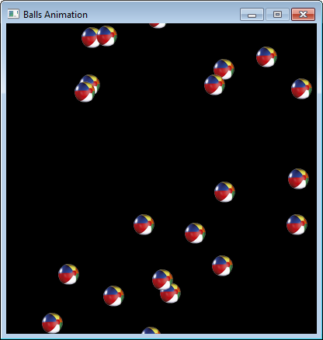
5. Multiple Balls Falling
Have 30 balls falling, and reappearing back at the top in random new positions.
Only one image is needed, but a list of 30 (x,y) positions.
then
starts
at the
top again

Slide 16
Code: animBalls.py
pygame.init()
screen = pygame.display.set_mode((400, 400))
pygame.display.set_caption("Balls Animation")
# load ball as image
ballIm = pygame.image.load('smallBall.png').convert_alpha()
# store dimensions for later
scrWidth, scrHeight = screen.get_size()
imWidth, imHeight = ballIm.get_size()
# initialize many random positions
posList = []
for i in range(30):
posList.append(randomPos())
# initialize ball's step done in each loop
xStep = 0; yStep = 8
clock = pygame.time.Clock()
:
The list is a list of [x,y] values, one for each ball:
[ [x0,y0], [x1,y1], …. ]

Slide 17
running = True
while running:
clock.tick(30)
# handle events
for event in pygame.event.get():
if event.type == QUIT:
running = False
# update game state
for i in range(len(posList)):
# if ball has exited bottom
if posList[i][1] > scrHeight-1:
posList[i] = randomPos()
# Move ball down
posList[i][1] += yStep
# redraw
screen.fill(BLACK)
for i in range(len(posList)):
# draw a ball at each position
screen.blit(ballIm, posList[i])
pygame.display.update()
pygame.quit()
The position of the ith ball (x, y) is stored in posList[i].
posList[i][0] == x
posList[i][1] == y

Slide 18
Revised randomPos()
def randomPos():
# create a random position
# x position somewhere along top
x = random.randrange(0, scrWidth -1 - imWidth)
# y position above the top
y = random.randrange(-scrHeight, 0)
return [x,y]
scrWidth - 1- imWidth
position a
ball anywhere
in this area
-scrHeight
(0,0)

Slide 19
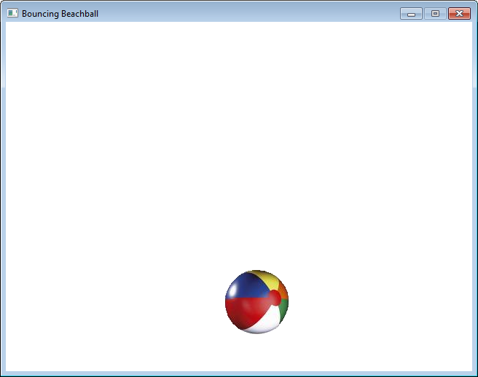
6. Bouncing Ball
Have a single ball bounce off the 'walls' of the screen.

Slide 20
Code: beachBounce.py
pygame.init()
screen = pygame.display.set_mode([640,480])
screen.fill(WHITE)
pygame.display.set_caption("Bouncing Beachball")
ballIm = pygame.image.load('ball.png').convert_alpha()
# store dimensions for later
scrWidth, scrHeight = screen.get_size()
imWidth, imHeight = ballIm.get_size()
# start position of the ball
x = 50; y = 50
# step size and direction along each axis
xStep = 10; yStep = 10
clock = pygame.time.Clock()
:

Slide 21
running = True
while running:
clock.tick(30)
# handle events
for event in pygame.event.get():
if event.type == QUIT:
running = False
# update game state
# change x-step direction at left and right sides
if (x <= 0) or (x >= scrWidth - 1 - imWidth):
xStep = -xStep
# change y-step direction at top and bottom sides
if (y <= 0) or (y >= scrHeight -1 - imHeight):
yStep = -yStep
x += xStep # move the ball horizontally
y += yStep # and vertically
# redraw
screen.fill(WHITE)
screen.blit(ballIm, [x, y])
pygame.display.update()
pygame.quit()

Slide 22
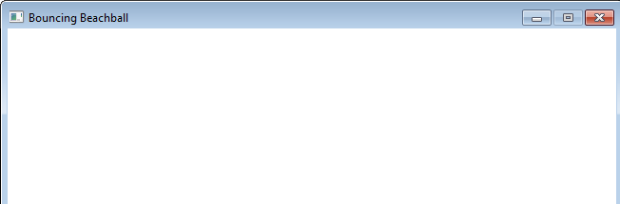
x- Direction Change
The x- direction depends on if xStep is positive or negative.
the direction is changed by swapping +/-
xStep = -xStep
It should change when the ball tries to leaves the screen on the left side or on the right side.
(0, y)
(scrWidth-1, y)
(x, y)
(x, y)
x >= scrWidth-1 -
imWidth
x <= 0
X
X

Slide 23
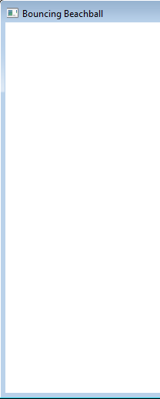
y- Direction Change
The y- direction depends on if yStep is positive or negative.
the direction is changed by swapping +/-
yStep = -yStep
It should change when the ball tries to leaves the screen on the top or bottom.
(x,0)
y <= 0
(x, y)
X
(x, y)
y >= scrHeight-1 -
imHeight
(scrHeight-1,0)
X

